Slide 1

INTERNET OF THINGS
Introduction to ESP32
Charanraj B R
Department of Computer Science & Engineering

Slide 2

INTERNET OF THINGS
Introduction to ESP32 Dev Board
Hands-on
Charanraj B R
Department of Computer Science & Engineering

Slide 3
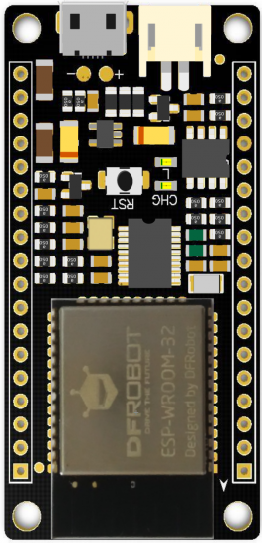
INTERNET OF THINGS
ESP32 Overview
Developed by ESPRESSIF Systems in 2016
Hybrid Bluetooth and Wi-Fi built on the board
Memory : 520KiB SRAM
Processor : Tensilica Xtensa LX6 microprocessor
Operating Frequency : 160 or 240 MHz
Ultra Low Power Consumption

Slide 4


INTERNET OF THINGS
Powering the ESP32
Micro USB
5V to the Vin Pin

Slide 5
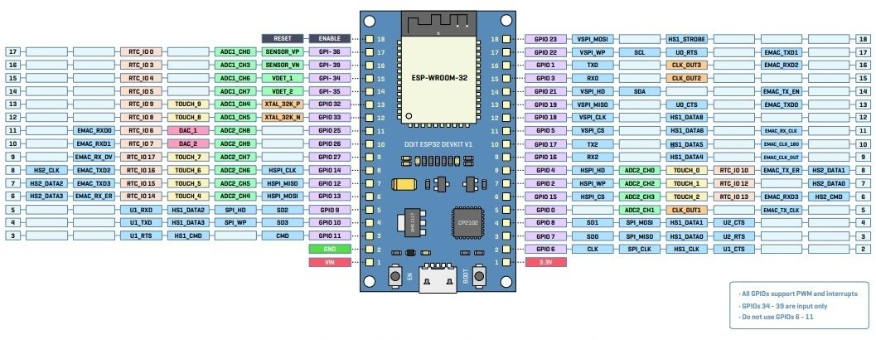
INTERNET OF THINGS
ESP32 Pinout Diagram
https://randomnerdtutorials.com/esp32-pinout-reference-gpios/

Slide 6

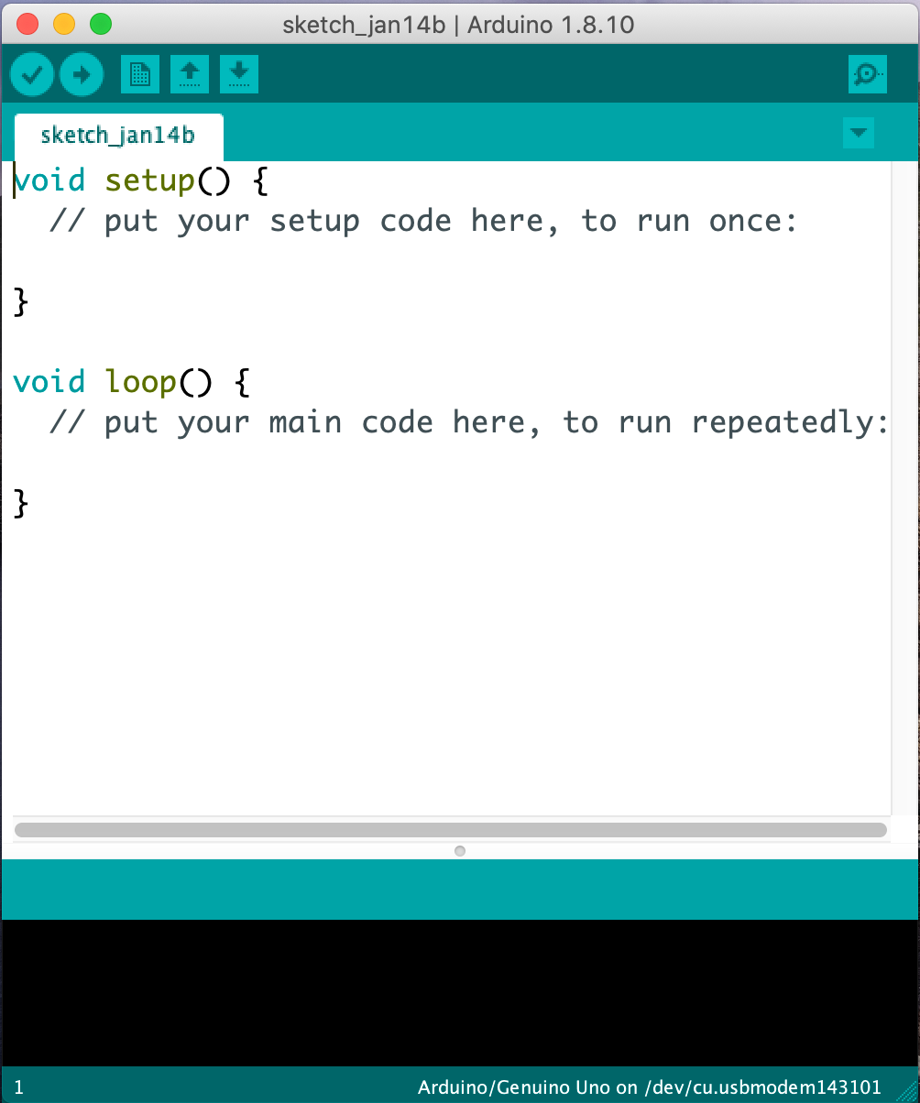
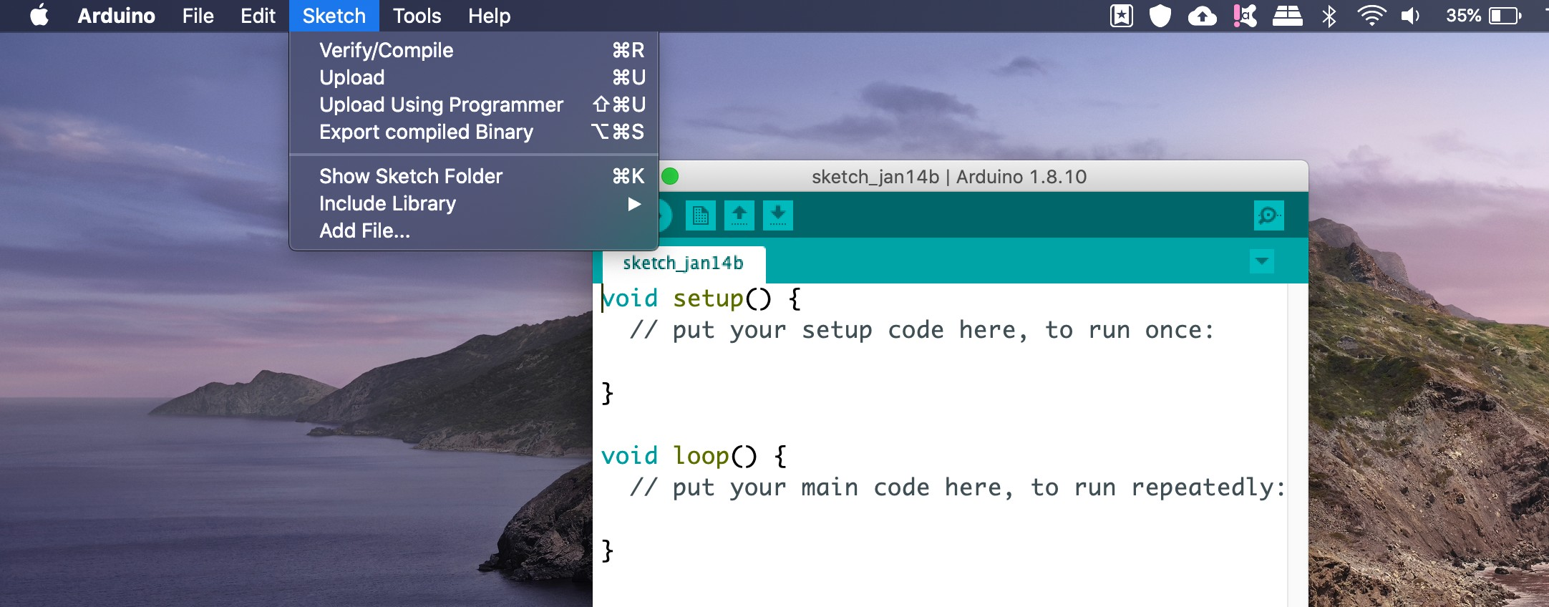
INTERNET OF THINGS
Brushing up Arduino IDE
Step 1 : Open IDE
Step 2 : Import required libraries under ‘Sketch’ Tab Libraries Link : https://github.com/espressif/arduino-esp32
Step 3 : Add the .zip file Library Added

Slide 7
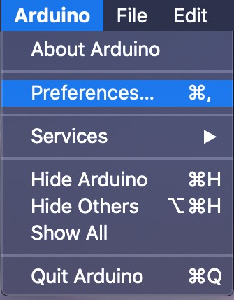
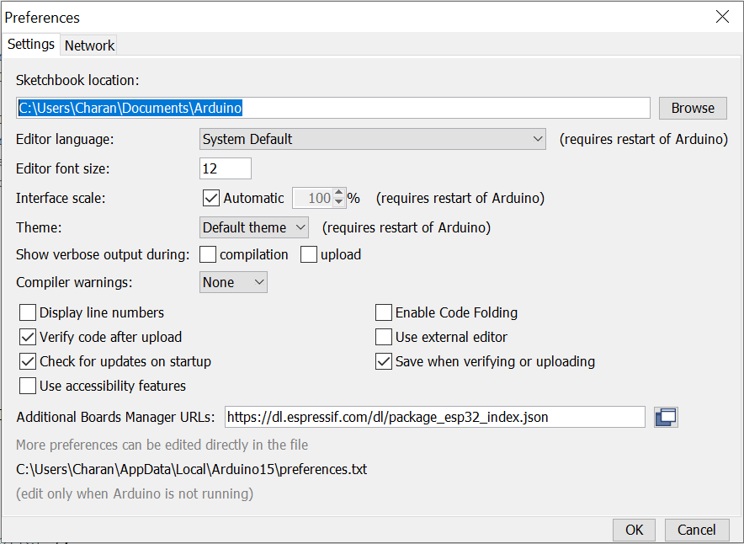
INTERNET OF THINGS
Adding ESP32 Board in the IDE
Step 1 : Click on Preferences
Step 2 : Add the following link in the field
Link : https://dl.espressif.com/dl/package_esp32_index.json

Slide 8
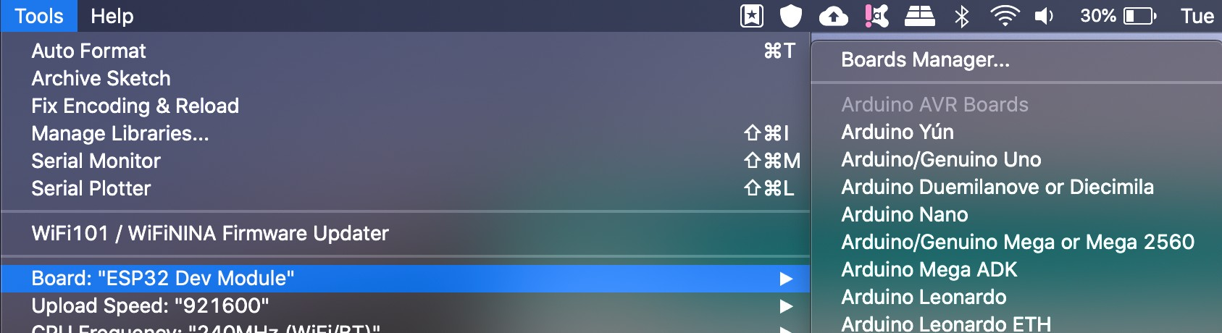
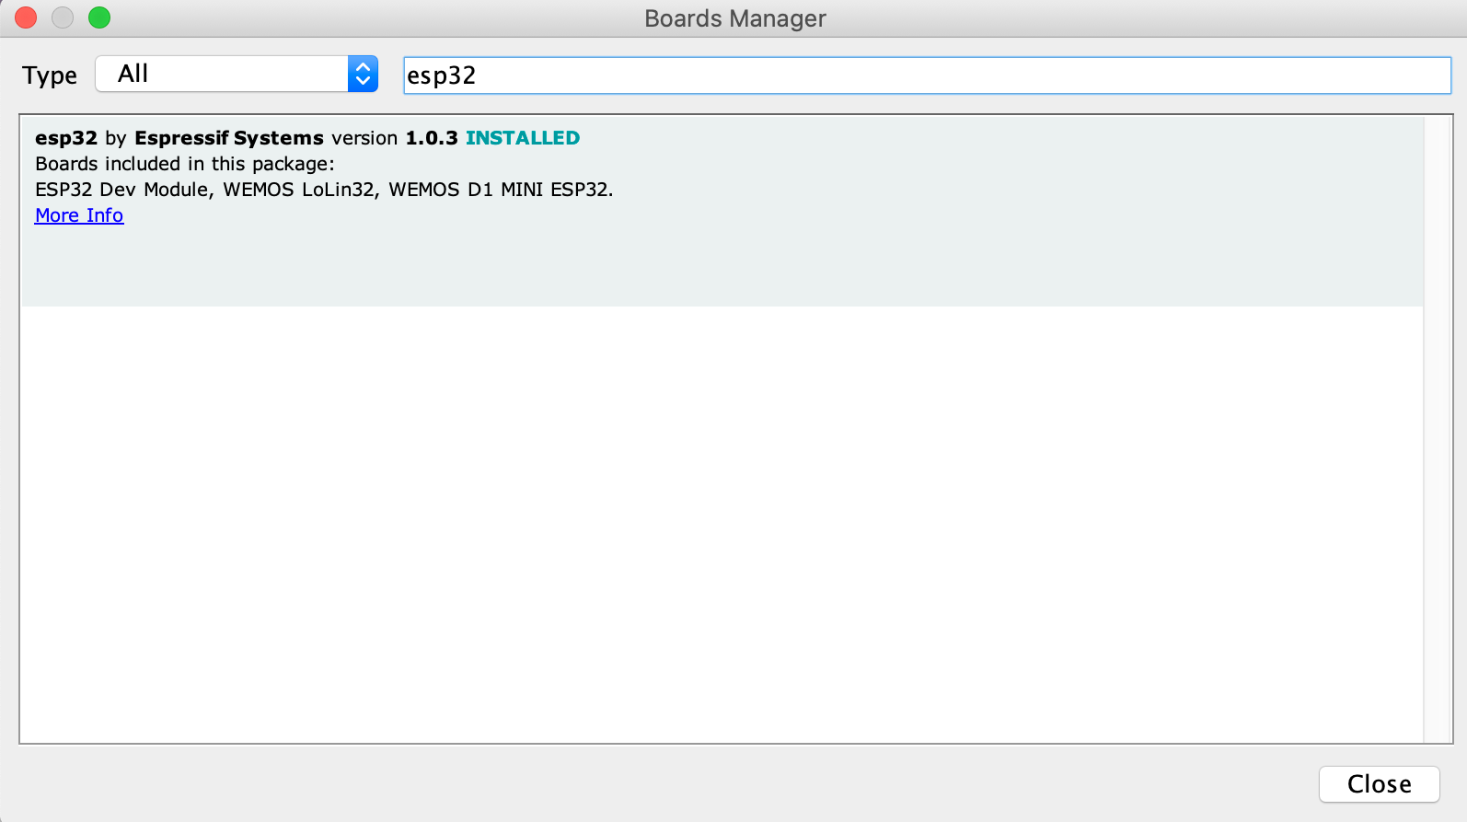
INTERNET OF THINGS
Adding ESP32 Board in the IDE
Step 3 : Click on Board Manager
Step 4 : Search for esp32 and install
You are all set!

Slide 9
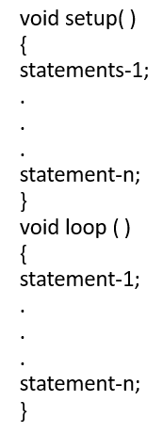

INTERNET OF THINGS
Basics of Arduino Programming
The setup function is the first to execute when the program is executed, and this function is called only once. The setup function is used to initialize the pin modes and start serial communication.
After the setup ( ) function is executed, the execution block runs next. The execution block hosts statements like reading inputs, triggering outputs, checking conditions

Slide 10
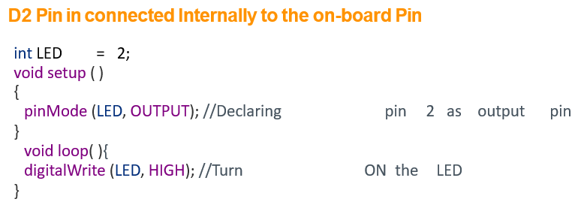

INTERNET OF THINGS
Task 1 - Turning on LED

Slide 11
INTERNET OF THINGS
Task 2 - Turning off LED

Slide 12
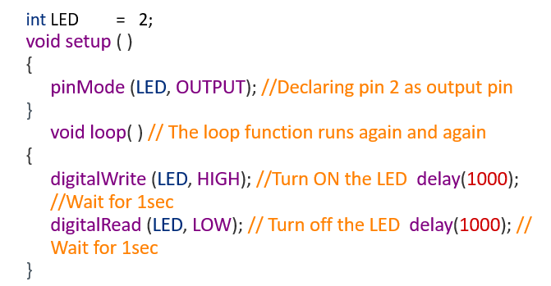
INTERNET OF THINGS
Task 3 - Blinking the LED
Note: Arduino always measures the time duration in millisecond. Therefore, whenever you mention the delay, keep it in milli seconds.

Slide 13
INTERNET OF THINGS
Do it at Home
1. Connecting 3 LEDs and Blinking them Sequentially
2. Connecting 4 LEDs and turning on Alternate ones
3. Blinking alternate LEDs Sequentially
Complete the tasks and upload to your EDMODO Profile

Slide 14

INTERNET OF THINGS
Connecting ESP32 to Wi-Fi
#include "WiFi.h“ Step 1
Step 2
const char* ssid = "yourNetworkName";
const char* password ="yourNetworkPass";
Note :
SSID - “PESU-Element Block”
Password - “”

Slide 15
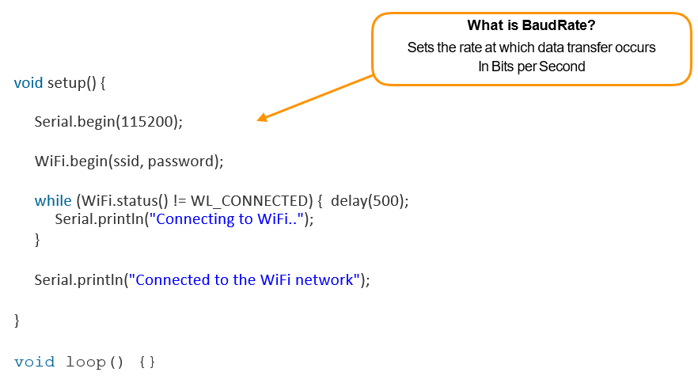
INTERNET OF THINGS
Step 3 - Build the setup function to connect to the Wi-Fi network

Slide 16
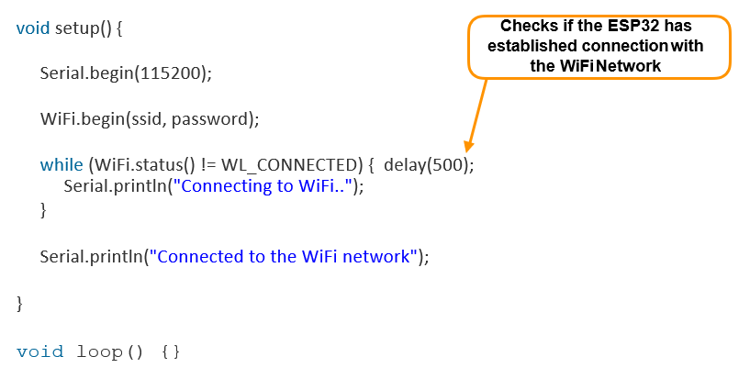
INTERNET OF THINGS
Step 3 - Build the setup function to connect to the Wi-Fi network

Slide 17
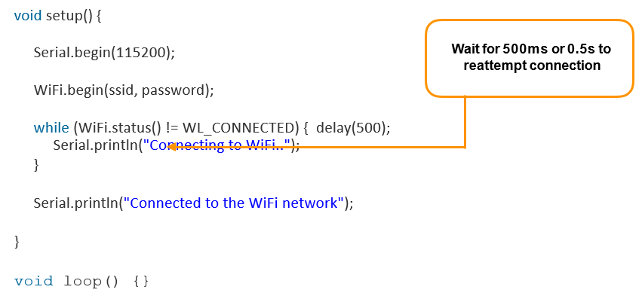
INTERNET OF THINGS
Step 3 - Build the setup function to connect to the Wi-Fi network

Slide 18
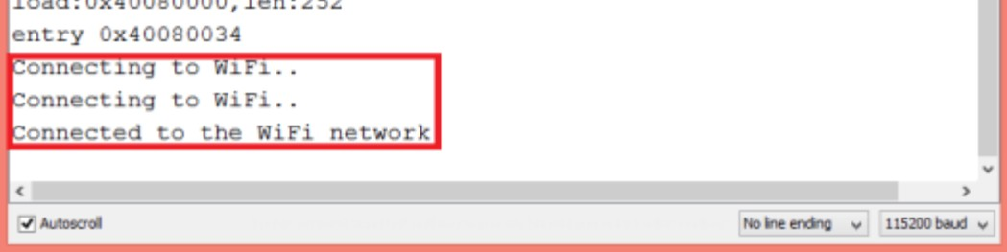
INTERNET OF THINGS
Step 4 – Test your code
Compile and Upload your code (press the ‘boot’ when upload starts)
Open Serial Monitor
Set baudrate to 115200
Press the ‘en’ button on the board
You must see the following,

Slide 19
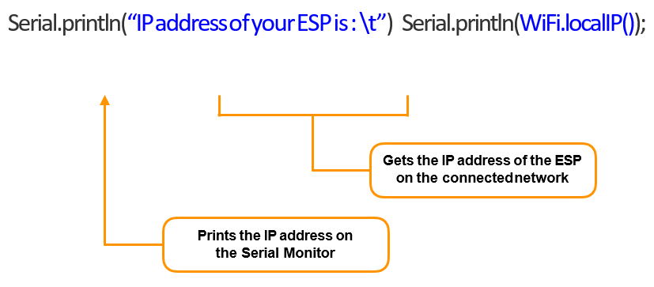
INTERNET OF THINGS
Step 5 – Getting the IP address of the ESP32

Slide 20
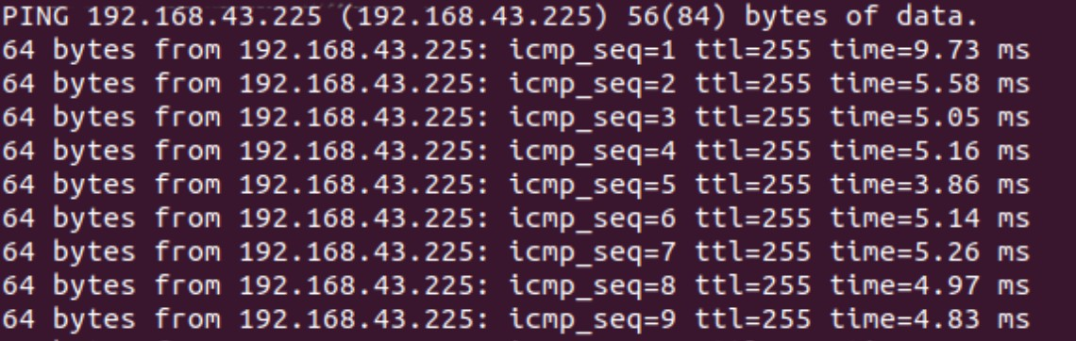
INTERNET OF THINGS
Step 6 – Testing the connection
Connect another laptop to the network
Open Terminal
Ping the ESPs IP Address
You should be able to see the following,

Slide 21
THANK YOU
Charanraj B R
Department of Computer Science & Engineering
charanrajbr@pes.edu

